Slide 1
CSE 6242 Project Trip Analyzer
The Unbiased and Interactive View of Tourism Data to Tourists
for Making Informed Decisions
Team 31
Ankur Agarwal | Xiaoqi Zheng
Brian Ng | Yiufung Leung
Si-Onn Kwok | Youjung Kim

Slide 2
How will you plan a vacation ?

Slide 3
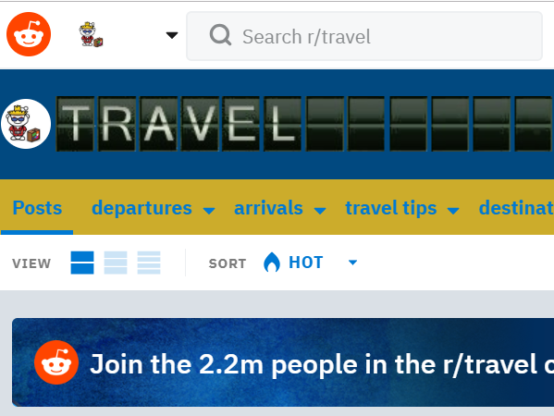
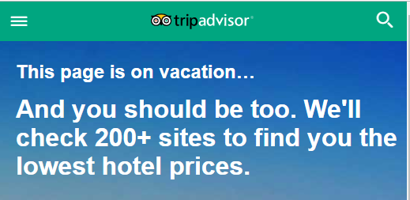
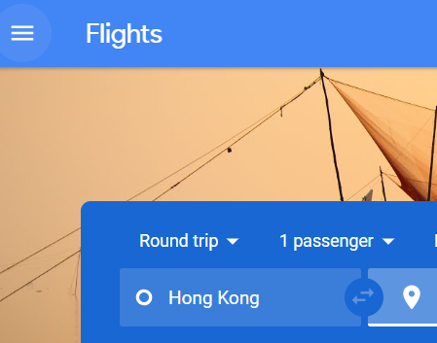

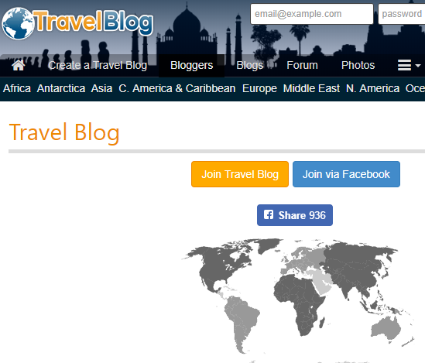
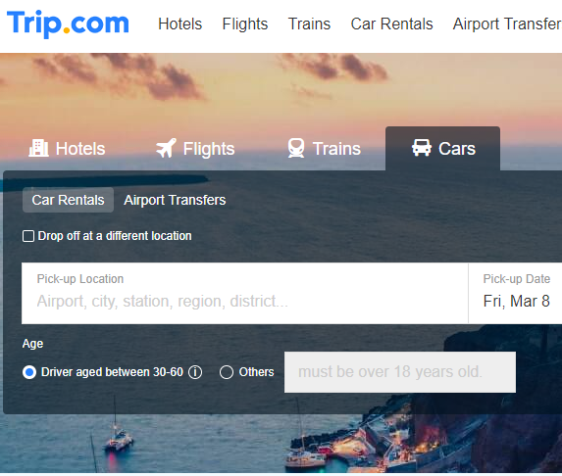
How is it done today?

Slide 4
What are the limits of current practice?
Users have to read multiple sites and consolidate information from different sources in order to make an informed decision.
These websites also rarely account for personal preference
When making recommendations (perhaps through a rating or review system) and tend to have a small biased towards the preference of people who are more likely to be vocal on such platforms

Slide 5
What are you trying to do?
Help traveler to plan their trip that fit their preference
The objective is to collect information through various sources and provide interactive view of the data to tourists customizable to their personal preferences.
Our focus is more on the process of organizing and managing the information as user needs and visualize them intuitively.

Slide 6
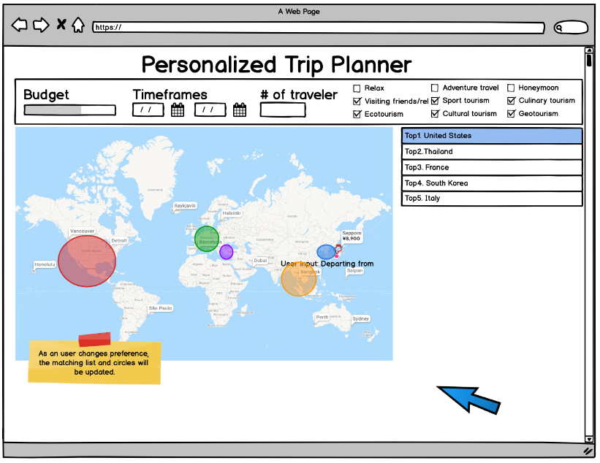
Prototype

Slide 7
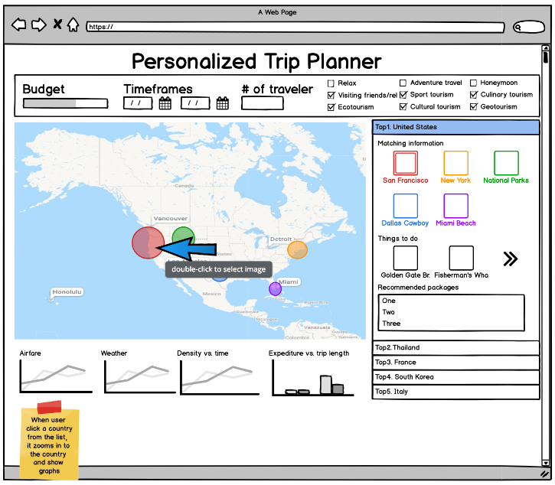
Recommendations

Slide 8
What’s new in your approach? Why will it be successful?
No other active site providing unbiased information
Dynamic data interaction coupled with user input of their preferences such as budget, preferred activities, and pace of travel, the recommendation system we are trying to implement would present with personalized vacation options.
Also, running sentiment analysis on social media platforms such as Reddit on potential destinations would help aggregate what users in general think about the destination instead of relying on ratings and reviews on travel websites.
There is a strong need for this service with unfilled demand

Slide 9
Who cares?
Tourist worldwide that wants a trip that fit their needs
Since the proposed solution is not limited to a geographical region and everyone is a tourist at some point, the proposed solution would appeal to an universal consumer base.

Slide 10
If you’re successful, what difference and impact will it make
Tourists can better plan their trips according to their unique demands and
save time and money searching
find a travel destination closer to their personal preferences.
The measure of success will be through review by volunteers and quantitative and qualitative feedbacks.

Slide 11
What are the risks and payoffs?
Complexity in data processing and data association sourced through multiple sources.
Most commercial sites do not offer free APIs to educational/personal projects and may require data scraping from these sites. Need to spend lots of time for scraping.
Costly to acquire information for paid API

Slide 12
How much will it cost?
The project intends to utilize opensource and freely available data sources and APIs. We will also put the site in free hosting site for development
no additional investment in first phase.

Slide 13
How long will it take?
First phase completed by April 19
(actual schedule/ adjusted plan shown in deep blue color)
Task | 1/27 | 2/3 | 2/10 | 2/17 | 2/24 | 3/3 | 3/10 | 3/17 | 3/24 | 3/31 | 4/7 | 4/14 | 4/19
Project Brain Storming
Research
Proposal presentation
Server setup
User Requirement
Design
Progress Report
Backend programming
Frontend programming
Integration
User Survey
Testing
Final Presentation

Slide 14
How long will it take?
First phase completed by April 19
Task | 1/27 | 2/3 | 2/10 | 2/17 | 2/24 | 3/3 | 3/10 | 3/17 | 3/24 | 3/31 | 4/7 | 4/14 | 4/19
Project Brain Storming
Research
Proposal presentation
Server setup
User Requirement
Design
Progress Report
Backend programming
Frontend programming
Integration
Testing
Final Presentation

Slide 15
What are the midterm and final “exams” to check for success? How will progress be measured.
Based on user feedback.
Project milestone will be measured by project task completion %.
For the midterm, we will conduct live review. of the draft version of our proposed solution and collect feedback via a short survey. The final version after incorporating some of the functionalities and suggestions received during midterm review would be presented again to the same group of volunteers and also to a small percentage of first time users.
The qualitative and quantitative feedback would constitute as measure of success.

Slide 16
Project Task Arrangement
Estimate work for Team members
Person | Time | Task
Ankur Agarwal | 120 | Research, Architecture, Report
Brian Ng | 120 | Research, Application
Si-Onn Kwok | 120 | Research, Recommendation System
Xiaoqi Zheng | 120 | Research, Front End
Yiufung Leung | 120 | Research, Social Media Analysis
Youjung Kim | 120 | Research, Backend
Total | 720 | (hrs)

Slide 17
Thank you

